Slide 1
Exploring Cryptography Protocols
with Limited Emphasis on Mathematics ☺
Presented By
@7eRoM

Slide 2
Attention
These slides have been crafted using the foundation of my MSc course in Cryptography Protocols at the University of ISfahan.
I've made adjustments to the content to align with the specific objectives of this presentation.
Also, My intention has been to minimize the use of mathematical concepts, which may result in some concepts being simplified or less precise.
Presented By
@7eRoM

Slide 3
Agenda
Identification and Entity Authentications Protocols
Zero Knowledge Protocols
Key Establishment Protocols
Threshold Cryptography and Secret Sharing Protocols
Special Purpose Protocols (like simultaneous contract signing, mental poker, fair exchange)
Identity Based Cryptography
Types of Digital Signatures
Secure Multiparty Computations

Slide 4
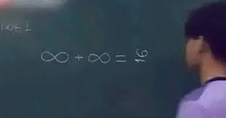
Secure Multiparty Computations

Slide 5
Secure Multiparty Computations
Content
Introduction
Yao’s Garbled Circuit
Median
k^{th} Element
Greater Than
Private Set Intersection
Private Bidding

Slide 6
Secure Multiparty Computations
Introduction
Computation between parties who do not trust each other
Example: elections
N parties, each one has a “Yes” or “No” vote
Goal: determine whether the majority voted “Yes”, but no voter should learn how other people voted
Example: auctions
Each bidder makes an offer
Offer should be committing! (can’t change it later)
Goal: determine whose offer won without revealing losing offers

Slide 7
Secure Multiparty Computations
Introduction
Example: distributed data mining
Two companies want to compare their datasets without revealing them
For example, compute the intersection of two lists of names
Example: database privacy
Evaluate a query on the database without revealing the query to the database owner
Evaluate a statistical query on the database without revealing the values of individual entries
Many variations

Slide 8
Secure Multiparty Computations
Introduction
Also known as Secure Multiparty Computation
2-party SFE: Alice has x, Bob has y, and they want to compute two functions f_{A}(x,y), f_{B}(x,y). At the end of the protocol
Alice learns f_{A}(x,y) and nothing else
Bob learns f_{B}(x,y) and nothing else

Slide 9
Secure Multiparty Computations
Introduction
n-party SFE: n parties each have a private input, and they join compute functions
How to let n parties, P₁,..,P_{n} compute a function F(x₁,..,x_{n})
Where input x_{i} is known to party P_{i}
Party P_{i} learns nothing more than what he can learn from his own input
and the final output F(x₁,..,x_{n})

Slide 10
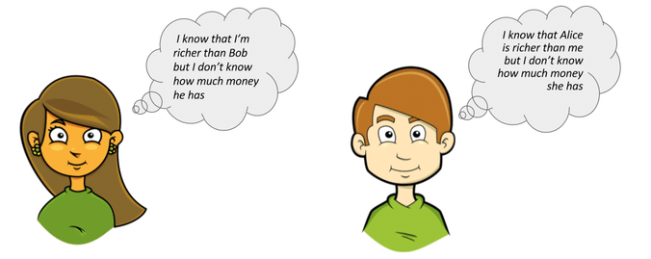
Secure Multiparty Computations
Introduction

Slide 11
Secure Multiparty Computations
Yao’s Garbled Circuit for 2-party SFE
For simplicity, assume that Alice has x, Bob has y, Alice learns f(x,y), and Bob learns nothing
represent f(x,y) using a boolean circuit
Alice encrypts the circuit and sends it to Bob
in the circuit each wire is associated with two random values
Alice sends the values corresponding to her input bits
Bob uses OT to obtain values for his bits
Bob evaluates the circuits and sends the result to Alice

Slide 12
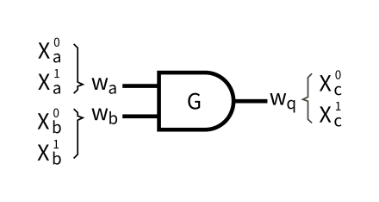
Secure Multiparty Computations
Yao’s Garbled Circuit for 2-party SFE
Alice holds a bit b_{A} and Bob holds a bit b_{B}. They want to jointly compute the AND of their private bits b_{A} ∧ b_{B}.
How can they do this privately?

Slide 13
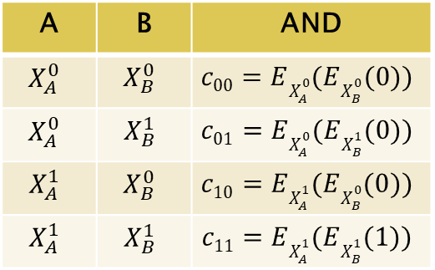
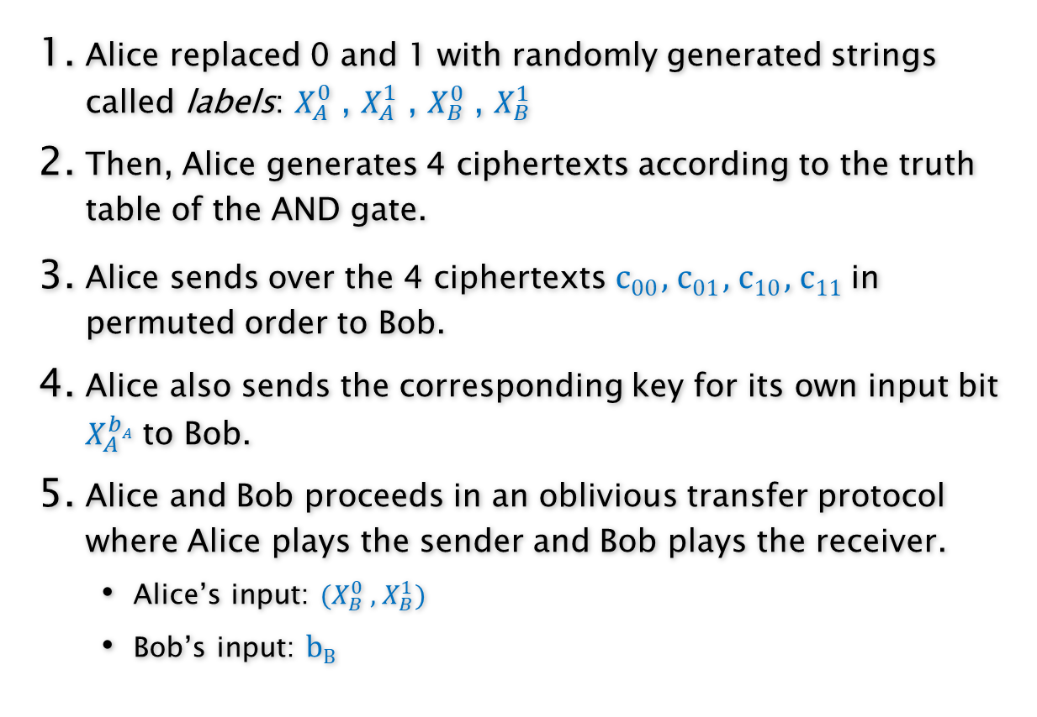
Secure Multiparty Computations
Yao’s Garbled Circuit for 2-party SFE
A | B | AND
0 | 0 | 0
0 | 1 | 0
1 | 0 | 0
1 | 1 | 1
Alice replaced 0 and 1 with randomly generated strings called labels: $X_{A}^{0}$ , $X_{A}^{1}$ , $X_{B}^{0}$ , $X_{B}^{1}$
Then, Alice generates 4 ciphertexts according to the truth table of the AND gate.
Alice sends over the 4 ciphertexts c₀₀ , c₀₁ , c₁₀ , c₁₁ in permuted order to Bob.
Alice also sends the corresponding key for its own input bit $X_{A}^{bA}$ to Bob.
Alice and Bob proceeds in an oblivious transfer protocol where Alice plays the sender and Bob plays the receiver.
Alice’s input: ($X_{B}^{0}$ , $X_{B}^{1}$)
Bob’s input: b_{B}
A | B | AND
$$X_{A}^{0}$$ | $$X_{B}^{0}$$ | $$c00=EX_{A}^{0}(EX_{B}^{0}(0))$$
$$X_{A}^{0}$$ | $$X_{B}^{1}$$ | $$c01=EX_{A}^{0}(EX_{B}^{1}(0))$$
$$X_{A}^{1}$$ | $$X_{B}^{0}$$ | $$c10=EX_{A}^{1}(EX_{B}^{0}(0))$$
$$X_{A}^{1}$$ | $$X_{B}^{1}$$ | $$c11=EX_{A}^{1}(EX_{B}^{1}(1))$$

Slide 14

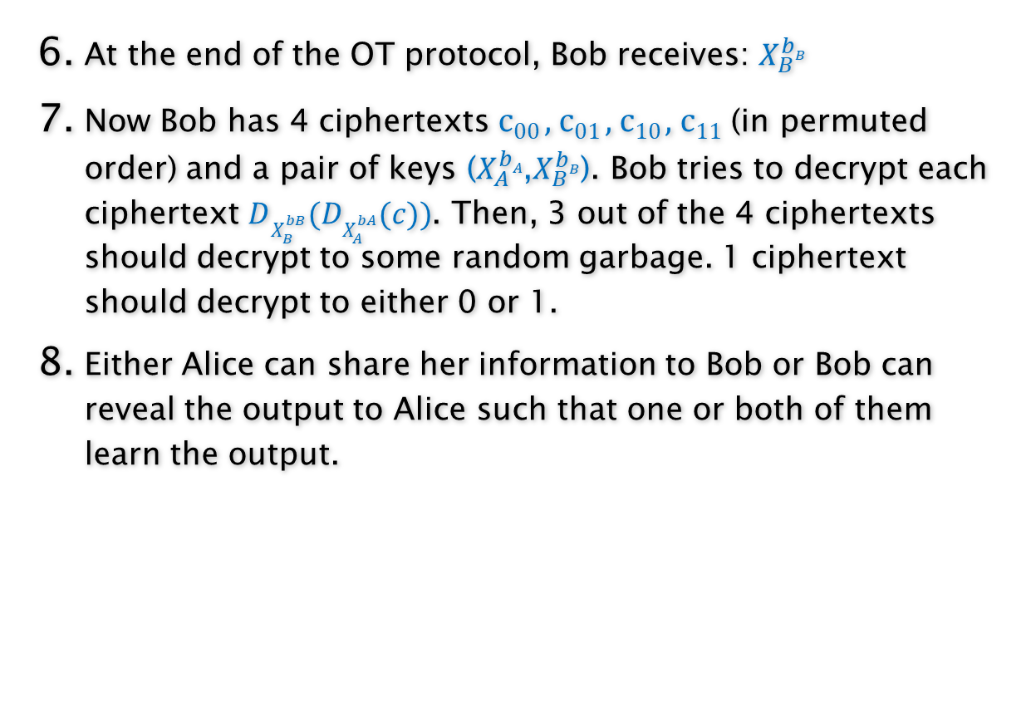
Secure Multiparty Computations
Yao’s Garbled Circuit for 2-party SFE
A | B | AND
0 | 0 | 0
0 | 1 | 0
1 | 0 | 0
1 | 1 | 1
At the end of the OT protocol, Bob receives: $X_{B}^{bB}$
Now Bob has 4 ciphertexts c₀₀ , c₀₁ , c₁₀ , c₁₁ (in permuted order) and a pair of keys ($X_{A}^{bA}$,$X_{B}^{bB}$). Bob tries to decrypt each ciphertext $DX_{B}^{bB}(DX_{A}^{bA}(c))$. Then, 3 out of the 4 ciphertexts should decrypt to some random garbage. 1 ciphertext should decrypt to either 0 or 1.
Either Alice can share her information to Bob or Bob can reveal the output to Alice such that one or both of them learn the output.
A | B | AND
$$X_{A}^{0}$$ | $$X_{B}^{0}$$ | $$c00=EX_{A}^{0}(EX_{B}^{0}(0))$$
$$X_{A}^{0}$$ | $$X_{B}^{1}$$ | $$c01=EX_{A}^{0}(EX_{B}^{1}(0))$$
$$X_{A}^{1}$$ | $$X_{B}^{0}$$ | $$c10=EX_{A}^{1}(EX_{B}^{0}(0))$$
$$X_{A}^{1}$$ | $$X_{B}^{1}$$ | $$c11=EX_{A}^{1}(EX_{B}^{1}(1))$$

Slide 15


Secure Multiparty Computations
Median (k = n/2)
Set S_{A}
Set S_{B}
Assume |S_{A}| = |S_{B}|
How can we find the median of S_{A} ∪ S_{B}

Slide 16
Secure Multiparty Computations
Median (k = n/2)
S_{A}
L_{A}
m_{A}
R_{A}
m_{A} < m_{B}
S_{B}
L_{B}
m_{B}
R_{B}
L_{A} lies below the median, R_{B} lies above the median.
New median is same as original median.
Recursion → Need log n rounds
(assume each set contains n=2^{i} items)

Slide 17
Secure Multiparty Computations
Median (k = n/2)
A deletes
elements ≤ m_{A}
B deletes
elements > m_{B}
YES
A finds its
median m_{A}
B finds its
median m_{B}
m_{A} < m_{B}
A deletes
elements > m_{A}
B deletes
elements ≤ m_{B}
NO
Secure comparison
(e.g. by circuit evaluation)

Slide 18
Secure Multiparty Computations
Median - Example
1
A
16
1
B
16
1
8
m_{A}>m_{B}
9
16
m_{A}<m_{B}
m_{A}<m_{B}
Median
found!!
m_{A}>m_{B}
m_{A}<m_{B}

Slide 19
Secure Multiparty Computations
Median - Arbitrary input size, arbitrary k
S_{A}
-∞
k
2^{i}
S_{B}
+∞
+∞
Size should be a power of 2
median of new inputs = k^{th} element of original inputs

Slide 20
Secure Multiparty Computations
k^{th} element - Hiding size of inputs
Can search for k^{th} element without revealing size of input sets.
However, k=n/2 (median) reveals input size.
Solution: Let S=2^{i} be a bound on input size.
Median of new
datasets is same
as median of
original datasets.
+∞
-∞
|S_{A}|
S
|S_{B}|
+∞
-∞

Slide 21
Secure Multiparty Computations
Greater Than
Compare
Define two sets of prefix strings:

Slide 22

Secure Multiparty Computations
Private Set Intersection
One-way PSI
Client: X = {x₁, …, x_{n}}
Server: Y = {y₁, …, y_{n}}
Output:
Client learns X ∩ Y
Server learns nothing
First, we need to learn about
Homomorphic Encryption

Slide 23
Secure Multiparty Computations
Homomorphic Encryption
Allows computations to be performed on encrypted data without first having to decrypt it
Enables mathematical computations to be performed directly on the encrypted data
Enables organizations to store encrypted data in a public cloud for future process
Enable new services by removing privacy barriers inhibiting data sharing or increasing security to existing services (for example, predictive analytics in health care)

Slide 24

Secure Multiparty Computations
Homomorphic Encryption
Given Enc(M1), ENC(M2), can compute (without knowing the decryption key)
Enc(M1+M2)
Enc(c· M1) for any constant c
I.e. Enc(a₀) + Enc(a₁)x +…+ Enc(a_{n})x^{n} = Enc(P(x))
Examples: El Gamal, Paillier
We could have discussed 1 or 2 sessions on Homomorphic Encryption.
However, we need to skip it for now.

Slide 25
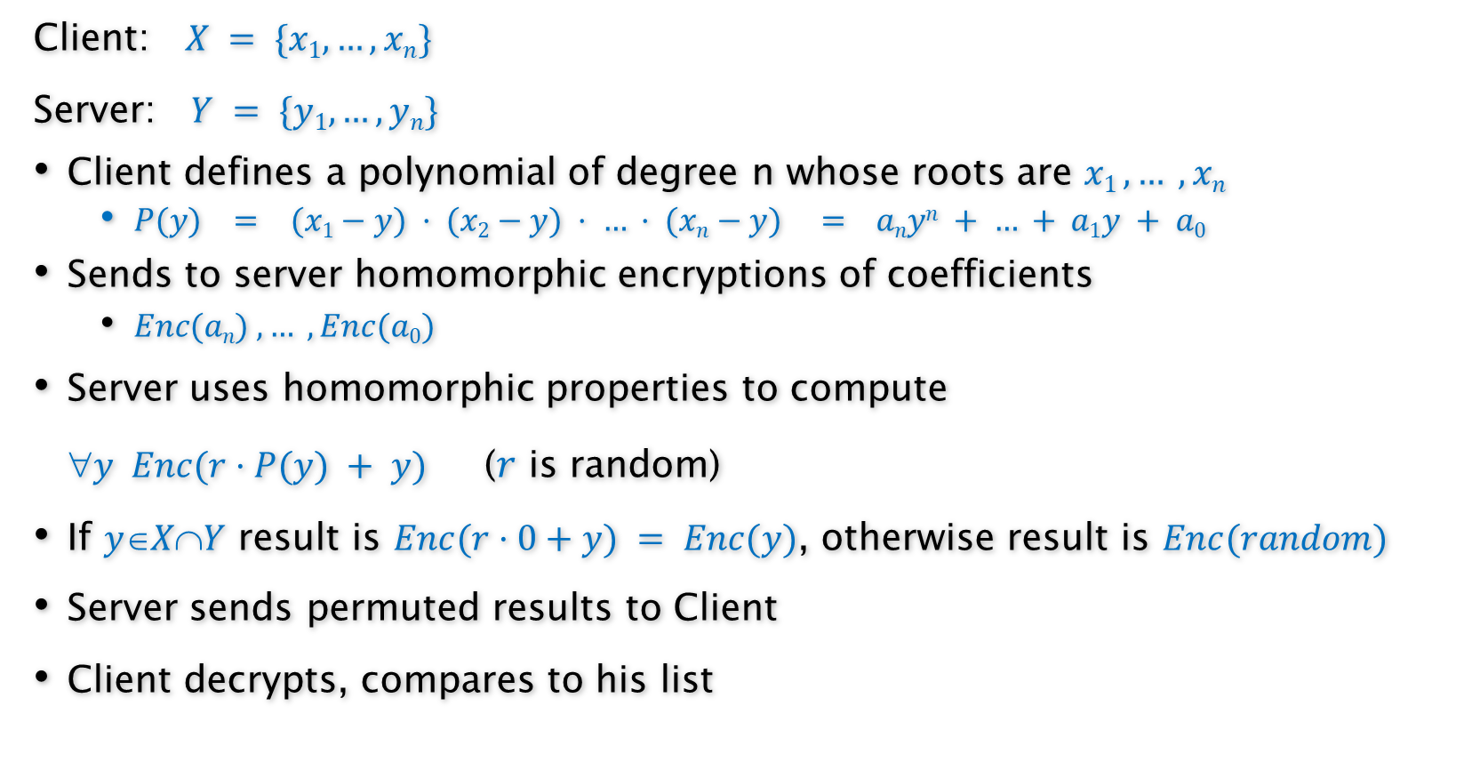
Secure Multiparty Computations
Private Set Intersection
Client: $X = \{x1, …, xn\}$
Server: $Y = \{y1, …, yn\}$
Client defines a polynomial of degree n whose roots are $x1 , … , xn$
$P(y) = (x1−y) · (x2−y) · … · (xn−y) = anyn + … + a1y + a0$
Sends to server homomorphic encryptions of coefficients
$Enc(an) , … , Enc(a0)$
Server uses homomorphic properties to compute
$y Enc(r·P(y) + y)$($r$ is random)
If $yXY$ result is $Enc(r·0+y) = Enc(y)$, otherwise result is $Enc(random)$
Server sends permuted results to Client
Client decrypts, compares to his list

Slide 26
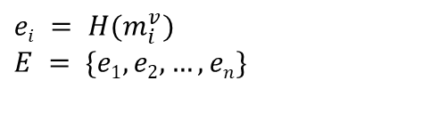
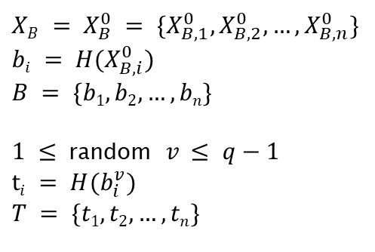
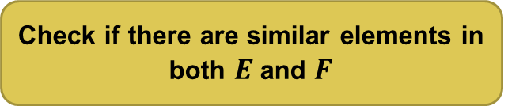
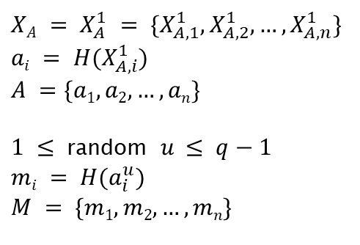
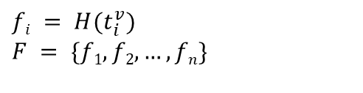
Special Purpose Protocols
Private Bidding
$XA = X_{A}^{1} = \{X_{A,1}^{1}, X_{A,2}^{1},…, X_{A,n}^{1}$}
$$ai = H(X_{A,i}^{1})$$
$$A =\{a1,a2,…,an\}$$
$1 ≤$ random $u ≤ q−1$
$$mi = H(a_{i}^{u})$$
$$M = \{m1,m2,…,mn\}$$
$XB = X_{B}^{0} = \{X_{B,1}^{0}, X_{B,2}^{0},…, X_{B,n}^{0}$}
$$bi = H(X_{B,i}^{0})$$
$$B = \{b1,b2,…,bn\}$$
$1 ≤$ random $v ≤ q−1$
$$ti = H(b_{i}^{v})$$
$$T = \{t1,t2,…,tn\}$$
M
T , E
$$fi = H(t_{i}^{v})$$
$$F = \{f1,f2,…,fn\}$$
$$ei = H(m_{i}^{v})$$
$$E = \{e1,e2,…,en\}$$
Check if there are similar elements in both $E$ and $F$

Slide 27

Secure Multiparty Computations
Learning Cryptography is straightforward!

Slide 28
Ref
Cryptography Protocols Course, Dr. Hamid Mala, University of Isfahan
https://crypto.stanford.edu/cs355/18sp/lec6.pdf
https://en.wikipedia.org/wiki/Garbled_circuit
https://en.wikipedia.org/wiki/Homomorphic_encryption
https://www.techtarget.com/searchsecurity/definition/homomorphic-encryption
https://www.researchgate.net/figure/Millionaires-problem_fig1_320290997
https://www.iconfinder.com/UsersInsights
https://www.iconfinder.com/Chanut-is
https://www.iconfinder.com/iconsets/softwaredemo

